Slide 1
R in ROGER
Myeong-Hun Jeong -- Postdoc
Johnathan Rush -- Education, Outreach, and Training
Coordinator
CyberGIS Center for Advanced Digital and Spatial Studies
National Center for Supercomputing Applications (NCSA)
University of Illinois at Urbana-Champaign
July, 14, 2016

Slide 2
Contents
Unit 1: What is R?
Intro to R
Unit 2: Scaling up R computation
Running R with parallel packages
Labs:
Lab 1: Running parallel R
Lab 2: Parallel spatial analysis -- Parallel spatial autocorrelation analysis (Moran’s I)
R and Hadoop
Labs:
Demo: RHadoop on Amazon EMR
Lab 3: SparkR

Slide 3
Unit 1: What is R?
“R is a free software environment for statistical computing and graphics. It compiles and runs on a wide variety of UNIX platforms, Windows and MacOS.”
https://www.r-project.org
In a general programming, you want computers to do things for you.
In as statistical programming, you want computers to learn things for you.
Available from The Comprehensive R Archive Network
http://cran.r-project.org/mirrors.html
Origin and History
Initially written by Ross Ihaka and Robert Gentleman at Department of Statistics of University of Auckland, New Zealand during 1990s.
International project since 1997.
Open source with GPL license
Free to anyone.
In actively development.

Slide 4
How to work with R
Downloading and installing R
Go to the R CRAN website (http://www.r-project.org/), and click on the download R link (http://cran.r-project.org/mirrors.html)
Downloading and installing RStudio
To write an R script, one can use R Console, R commander, or any text editor (EMACS, VIM, or sublime).
However, the assistance of RStudio, an integrated development environment (IDE) for R, can make development a lot easier.
Access RStudio's official site by using the following URL: http://www.rstudio.com/products/RStudio/.
Rstudio IDE cheat sheethttp://www.rstudio.com/wp-content/uploads/2016/01/rstudio-IDE-cheatsheet.pdf

Slide 5
How to work with R
Materials for this workshop
1. Copy files directly for this course
$ ssh cgtrnXX@roger-login.ncsa.illinois.edu
~cgtrnxx$ mkdir cybergis_r
~cgtrnxx$ cp -r /projects/EOT/cybergis_R_summer_2016/* cybergis_r/
~cgtrnxx$ cd cybergis_r(change directory)
~cgtrnxx$ ls (list all files in your current directory)

Slide 6
How to work with R
R as a calculator
> 4 + 1 - 2 #add and subtract
[1] 3
Assignments
> x <- 8 #The object (variable) x holds the value 8
> x
[1] 8
Value comparisons
> 2 == 2 #Equality
> 2 != 2 #inequality
Executing functions
> print(x) #print() is a function. It prints its argument, x.
[1] 8
>ls() #lists the objects in memory
[1] “x”
>rm(x) #remove x from memory
>ls() #no objects in memory, therefore:
character(0)

Slide 7
How to work with R
Basic data structures
Vector: An ordered collection of data of the same type
> x <- 0: 5
>x
[1] 0 1 2 3 4
Matrix: A rectangular table of data of the same type
> mdat <- matrix(c(1,2,3, 11,12,13), nrow = 2, ncol = 3)
List: An ordered collection of data of arbitrary types.
>person = list(name=“Matt”, age=30, married=F)
>person$name
[1] “Matt”
Data frames: A special kind of list used for storing dataset tables
>dfr1 <- data.frame( ID=1:4,
FirstName=c("John","Jim","Jane","Jill"),
Female=c(F,F,T,T),
Age=c> (22,33,44,55) )
>dfr1$FirstName
[1] John Jim Jane Jill

Slide 8
How to work with R
Flow control and loops
# if (condition) expr1 else expr2
>x <- 5; y <- 10
>if (x==0) y <- 0 else y <- y/x #
>Y
##[1] 2
# for (variable in sequence) expr
ASum <- 0
for (i in 1:x)
{
ASum <- ASum + i
}
ASum # equivalent to sum(1:x)
##[1] 15
Plots
> plot(x <- sort(rnorm(47)), type = "l", main = "plot(x, type = \"s\")")
Help
Help(plot)
Installing packages
> install.packages(Stats) #This package contains functions for statistical calculations and random number generation.

Slide 9
Unit 2: Scaling up R computation
R’s limitation to large-scale data analysis¹
It’s single-threaded
The R language has on explicit constructs for parallelism, such as threads. An out-of-the-box R install cannot take advantage of multiple CPUs.
It’s memory-bound
R requires that your entire dataset fit in memory (RAM). Four gigabytes of RAM will not hold eight gigabytes of data, no matter how much you smile when you ask.
Solution:
Spreading work across multiple CPUs overcomes R’s single-threaded nature.
Offloading work to multiple machines reaps the multi-process benefit and also addresses R’s memory barrier.
1. McCallum, Q. E. and Weston S. (2012). Parallel R. O’Reilly Media, Inc. 2011

Slide 10
Scaling up R computation
What to do if the computation is too big for a single desktop?
Using automatically offloading with multicore/GPU.
HiPLAR (High Performance Linear Algebra in R): use the latest multi-core and GPU libraries to give substantial speed-ups to existing linear algebra functions in R.
Advantage:
No code changes needed
User can run R solution as before without knowledge of the parallel execution.
Limitations:
Only support limited computational operations.
Break big computation with multiple job submission
Running R in non-interactive session
Rhadoop and SparkR packages
Advantage:
Utilize efficiency of other data intensive processing framework
Each job can use existing R code
Limitations:
A “data-parallel” solution that may not suitable for simulation based analysis
Notes:
Basic Linear Algebra Subprograms (BLAS) performs low-level linear
algebra subroutine operations such as copying, scaling, dot products, linear
combinations, and matrix multiplication.
Linear Algebra Package (LAPACK) performs numerical routines such
as solving linear equations, linear least-squares, and matrix factorizations
(SVD, LU, QR, Cholesky and Schur).

Slide 11
Scaling up R computation
What to do if the computation is too big for a single desktop?
Implement code using parallel packages.
Parallel packages: snow, parallel, or foreach
Advantage:
Do whatever you want with them
Get the best performance
Limitations:
Need code development
In some case, the analysis workflow may need be changed.

Slide 12
Unit 2.1 Running R with parallel packages
Objective:
Run R with a couple of parallel packages.
Investigate resource pressures between serial and parallel approaches.
Parallel spatial analysis -- Parallel spatial autocorrelation analysis (Moran’s I).

Slide 13
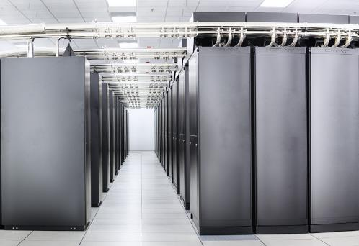


+
=

Slide 14
Serial version of R code
To run myProc() 10 times using apply
ptm <- proc.time()
#sapply converts results into a vector or array of appropriate size
result <- sapply(1:10, function(i) myProc())
proc.time() – ptm
=> user system elapsed
14.929 0.232 35.179
myProc function
#Define a simple R function
myProc <- function(size=10000000) {
#Load a large vector
vec <- rnorm(size)
#Now sleep on it
Sys.sleep(2)
#Now sum the vec values
return(sum(vec))
}

Slide 15
Running R with parallel packages
Parallel: mclapply
The parallel package provides several methods for parallelizing your work.
'mclapply' can only used for single-node parallelism.
require(parallel)
ptm <- proc.time()
result <- mclapply(1:10, function(i) myProc(), mc.cores=10)
proc.time() – ptm
=> user system elapsed
0.012 0.025 4.616

Slide 16
Running R with parallel packages
Snow
SNOW uses either MPI or socket based connections to achieve parallelism.
This means it can use cores on both the local and remote nodes.
require(snow)
#Create a cluster object
hostnames <- rep('localhost', 10)
cluster <- makeSOCKcluster(hostnames)
#Assigns the values on the master of the variables named in list to variables of the same names in the global environments of each node.
clusterExport(cluster, list('myProc'))
ptm <- proc.time()
#Call function on the first cluster node with arguments seq[[1]] and ..., on the second node with seq[[2]] and ..., and so on. If the length of seq is greater than the number of nodes in the cluster then cluster nodes are recycled.
result <- clusterApply(cluster, 1:10, function(i) myProc())
proc.time() - ptm
=> user system elapsed
0.006 0.001 4.053
#To shut down the cluster
stopCluster(cluster)

Slide 17
Running R with parallel packages
Snow: Load balancing with clusterApplyLB
clusterApplyLB is a load balancing version of clusterApply.
Instead scheduling tasks in a round-robin fashion, it sends new tasks to the cluster worker as they complete their previous task.
clusterApply() pushes tasks to the workers, while clusterApplyLB() lets the workers pull tasks as needed.
require(snow)
#Create a cluster object
hostnames <- rep('localhost', 4)
cluster <- makeSOCKcluster(hostnames)
#15 observations, mean = 15, sd = 15
sleeptime <- abs(rnorm(15,15,15))
#snow.time collects and returns timing information for cluster usage
tm <- snow.time(clusterApplyLB(cluster,sleeptime,Sys.sleep))
plot(tm)
stopCluster(cluster)

Slide 18
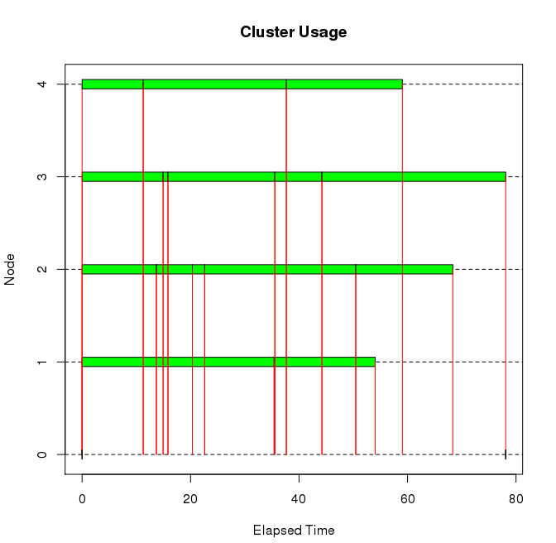
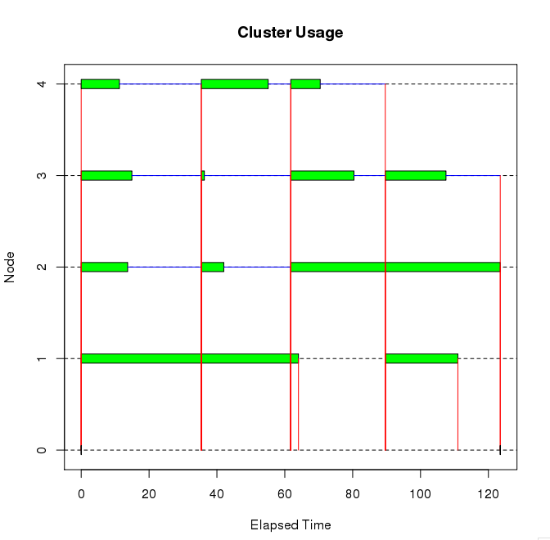
Running R with parallel packages
Snow: Load balancing with clusterApplyLB
clusterApplyLB() is much efficient than clusterApply() in this example: 78 seconds for clusterApplyLB(), and 120 seconds for clusterApply()
clusterApplyLB()
clusterApply()

Slide 19
Running R with parallel packages
foreach + snow
'foreach' is a package that makes parallelization easier.
'foreach' uses other parallel functions under the hood, but hides some of the complexity.
require(foreach)
require(doSNOW)
hostnames <- rep('localhost', 10)
cluster <- makeSOCKcluster(hostnames)
#register the SNOW parallel backend with the foreach package.
registerDoSNOW(cluster)
ptm <- proc.time()
#'c' is useful for concatenating the results into a vector.
result <- foreach(i=1:10, .combine=c) %dopar% {
myProc()
}
proc.time() - ptm
user system elapsed
0.023 0.010 4.983
stopCluster(cluster)

Slide 20
Running R with parallel packages
Bootstrap calculations.
Serial implementation.
random.data <- matrix(rnorm(1000000), ncol = 1000)
bmed <- function(d, n) median(d[n])
library(boot)
sapply(1:100, function(n) {sd(boot(random.data[, n], bmed, R = 10000)$t)})
=> user system elapsed
103.305 0.828 224.822
Parallel implementation
require(foreach)
require(doSNOW)
cluster = makeCluster(10, type = "SOCK")
clusterExport(cluster, c("random.data", "bmed"))
results = foreach(n = 1:100, .combine = c) %dopar% {
library(boot); sd(boot(random.data[, n], bmed, R = 10000)$t)
}
stopCluster(cluster)
user system elapsed
0.340 0.069 21.037

Slide 21
Running R with parallel packages
foreach + snow for multi-nodes
Set up environmental setting (Before setting the environmental variable, you must quit R)
vim ~/.bashrc
Put the information to load module R and then save the file
module load R
Assign the number of nodes.
qsub -I -l nodes=2 #The -I option tells qsub you want to run an interactive job on the compute nodes.
Start R
require(foreach)
require(doSNOW)
#Get backend hostnames
nodelist <- Sys.getenv("PBS_NODEFILE")
hostnames <- scan(nodelist, what="", sep="\n")
cluster <- makeSOCKcluster(hostnames)
registerDoSNOW(cluster)
ptm <- proc.time()
result <- foreach(i=1:100, .combine=c) %dopar% {
myProc()
}
proc.time() - ptm
stopCluster(cluster)

Slide 22
Running R with parallel packages
Executing snow programs on a cluster with Rmpi
library(Rmpi)
library(snow)
# Tell mpi which hosts to use
nodefile <- Sys.getenv("PBS_NODEFILE")
hostnames <- scan(nodefile, what="", sep="\n")
# Spawn slaves (one less than the number of core specified with qsub)
mpi.spawn.Rslaves(nslaves=length(hostnames)-1,needlog = FALSE )
# Tell all slaves to return a message identifying themselves
mpi.bcast.cmd( id <- mpi.comm.rank() )
mpi.bcast.cmd( np <- mpi.comm.size() )
mpi.bcast.cmd( host <- mpi.get.processor.name() )
result <- mpi.remote.exec(paste("I am", id, "of", np, "running on", host))
print(unlist(result))
# Tell all slaves to close down, and exit the program
mpi.close.Rslaves(dellog = FALSE)
mpi.quit()

Slide 23
Lab 1: Running parallel R
Objective:
Learn how to run parallel R
Successful outcome:
Investigate resource pressures between serial and parallel approaches.
Before you begin:
Environmental variable setting
vi ~/.bashrc -- open bashrc file
module load R/3.2.1-openmpi gdal-stack -- put this line and exit the file after saving.
source ~/.bashrc – refresh the bashrc file.

Slide 24
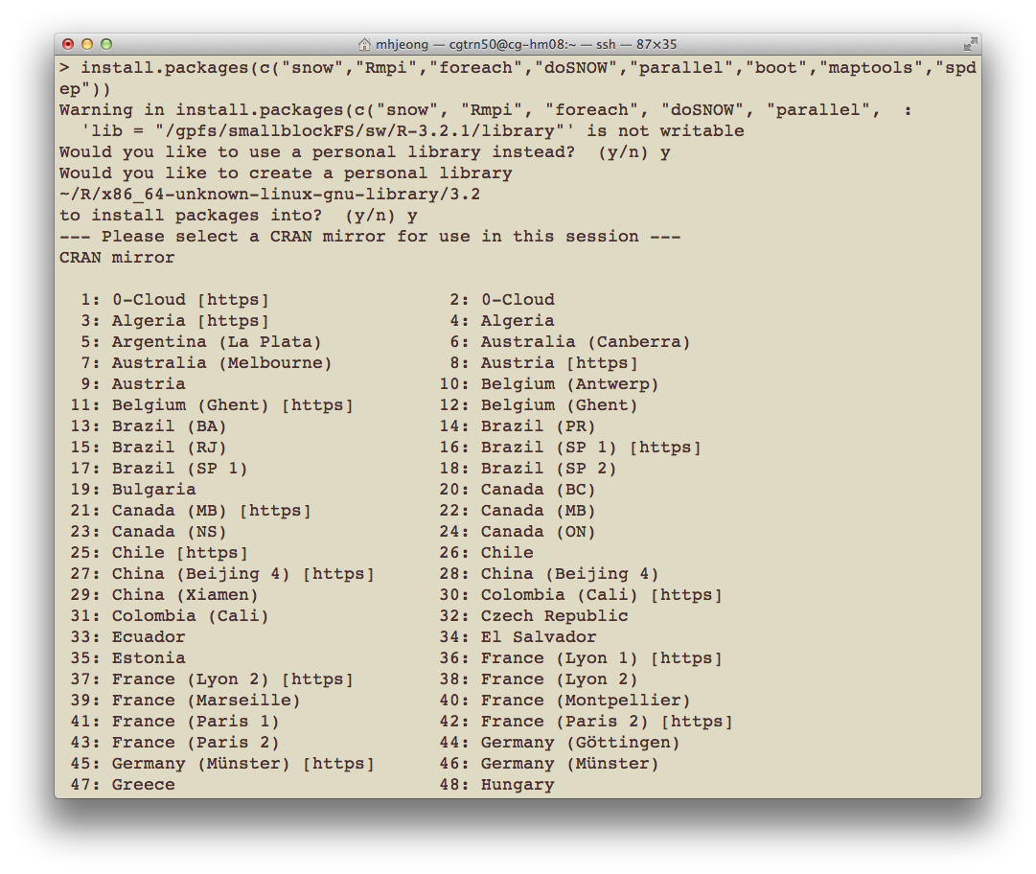
Running parallel R
Perform the following steps:
Step 1: Install packages for this course.
$ R #Start R
Install packages for this course.
install.packages(c("snow","Rmpi","foreach","doSNOW","parallel","boot","maptools","spdep"))

Slide 25
Running parallel R
Step 2: Define a simple R function.
myProc <- function(size=10000000) {
#Load a large vector
vec <- rnorm(size)
#Now sleep on it
Sys.sleep(2)
#Now sum the vec values
total <- 0
for(v in vec) {
total <- total + v
}
}

Slide 26
Running parallel R
Step 3: To run myProc() 10 times using apply.
ptm <- proc.time()
#sapply converts results into a vector or array of appropriate size
result <- sapply(1:10, function(i) myProc())
proc.time() – ptm
=> user system elapsed
14.929 0.232 35.179

Slide 27
Running parallel R
Step 4: To run myProc() 10 times using a parallel package.
require(parallel)
ptm <- proc.time()
result <- mclapply(1:10, function(i) myProc(), mc.cores=10)
proc.time() – ptm
=> user system elapsed
0.012 0.025 4.616

Slide 28
Running parallel R
Step 5: To run myProc() 10 times using a SNOW package.
require(snow)
#Create a cluster object
hostnames <- rep('localhost', 10)
cluster <- makeSOCKcluster(hostnames)
#Assigns the values on the master of the variables named in list to variables of the same names in the global environments of each node.
clusterExport(cluster, list('myProc'))
ptm <- proc.time()
#Call function on the first cluster node with arguments seq[[1]] and ..., on the second node with seq[[2]] and ..., and so on. If the length of seq is greater than the number of nodes in the cluster then cluster nodes are recycled.
result <- clusterApply(cluster, 1:10, function(i) myProc())
proc.time() - ptm
=> user system elapsed
0.006 0.001 4.053
#To shut down the cluster
stopCluster(cluster)

Slide 29
Running parallel R
Step 6: To run myProc() 10 times using foreach + SNOW packages.
require(foreach)
require(doSNOW)
hostnames <- rep('localhost', 10)
cluster <- makeSOCKcluster(hostnames)
#register the SNOW parallel backend with the foreach package.
registerDoSNOW(cluster)
ptm <- proc.time()
#'c' is useful for concatenating the results into a vector.
result <- foreach(i=1:10, .combine=c) %dopar% {
myProc()
}
proc.time() - ptm
user system elapsed
0.023 0.010 4.983
stopCluster(cluster)

Slide 30
Running parallel R
Step 7: Bootstrap calculations.
Serial implementation.
random.data <- matrix(rnorm(1000000), ncol = 1000)
bmed <- function(d, n) median(d[n])
library(boot)
sapply(1:100, function(n) {sd(boot(random.data[, n], bmed, R = 10000)$t)})
=> user system elapsed
103.305 0.828 224.822
Parallel implementation
library(doSNOW)
cluster = makeCluster(10, type = "SOCK")
clusterExport(cluster, c("random.data", "bmed"))
results = foreach(n = 1:100, .combine = c) %dopar% {
library(boot); sd(boot(random.data[, n], bmed, R = 10000)$t)
}
stopCluster(cluster)
user system elapsed
0.340 0.069 21.037

Slide 31
Running parallel R
Step 8: Bootstrap calculations with multi-nodes.
You need to quit R if your are in R session.
q()
Change directory
cd ~/cybergis_r/rmpi
Change an email address in multinodes.sh file
vim multinodes.sh
Run qsub script
qsub multinodes.sh
You can see the results in multinodes.log file

Slide 32
Running parallel R
Step 9: Rmpi.
You need to quit R if your are in R session.
q()
Change directory
cd ~/cybergis_r/rmpi
Change an email address in multinodes.sh file
vim multinodes.sh
Run qsub script
qsub hello.sh
You can see the results in hello.log file

Slide 33
Lab 2: Parallel spatial analysis
Objective:
Learn how to calculate parallel spatial autocorrelation (Moran’s I)
Location of files:
cybergis_r
Successful outcome:
You will calculate a spatial autocorrelation index, based on serial and parallel approaches.
Before you begin:
SSH into the ROGER system.
Make a data directory and copy shape files into the data directory
cp -r /projects/EOT/cybergis_R_summer_2016/* cybergis_r/

Slide 34
Parallel spatial analysis
A large and growing number of libraries for handling spatial data in R have been developed.
spdep package
A collection of functions to create spatial weights matrix objects from polygon contiguities, from point patterns by distance and tessellations, for summarizing these objects, and for permitting their use in spatial data analysis.
https://cran.r-project.org/web/packages/spdep/index.html
Spatial package
Functions for kriging and point pattern analysis.
https://cran.r-project.org/web/packages/spatial/index.html
GISTools package
Mapping and spatial data manipulation tools.
https://cran.r-project.org/web/packages/GISTools/index.html

Slide 35
Parallel spatial analysis
maptools package
Set of tools for manipulating and reading geographic data.
https://cran.r-project.org/web/packages/maptools/index.html
sp package
A package that provide classes and methods for spatial data;
https://cran.r-project.org/web/packages/sp/index.html
There are more available spatial packages. However, these packages are not available for parallel computations.
Notes:
Spatial autocorrelation is a descriptive statistic for spatially referenced attributed data.
Many statistical test and models are based on the assumption that each observation in a set of measurements is distributed independently of the others.
This common assumption is frequently untrue for spatial data.

Slide 36
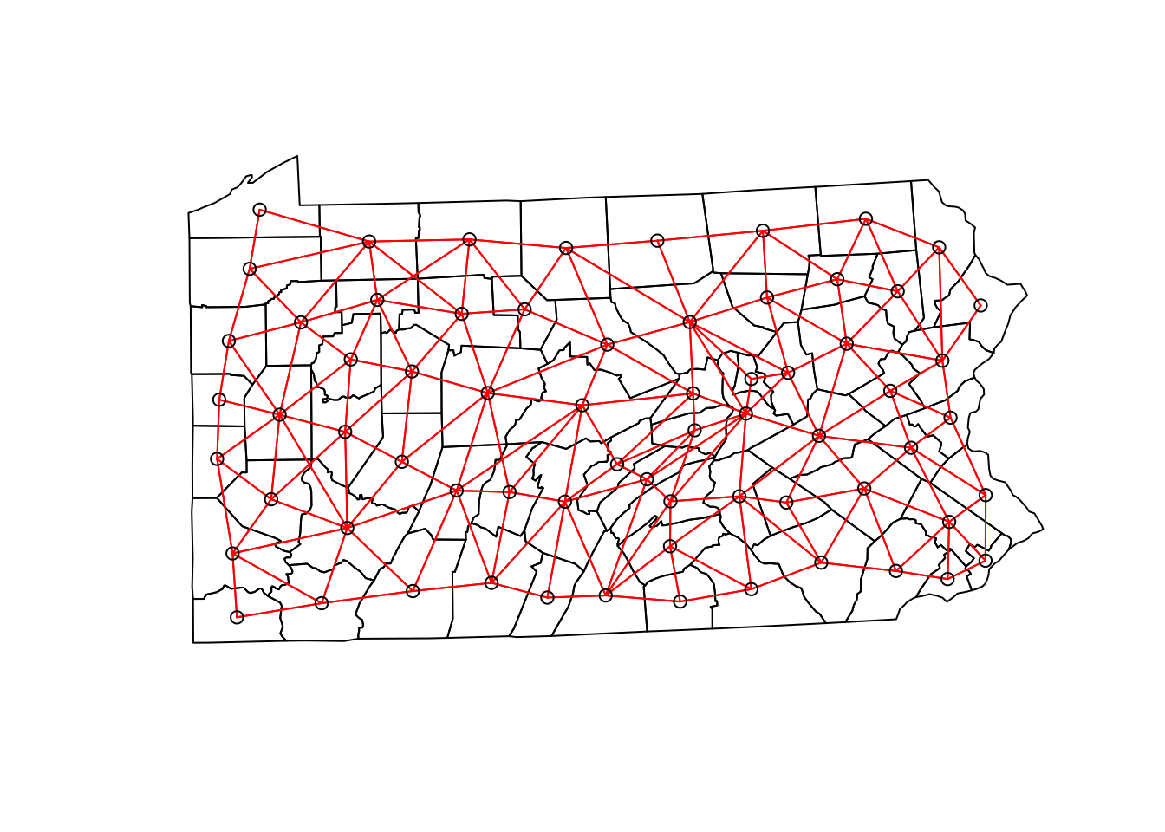
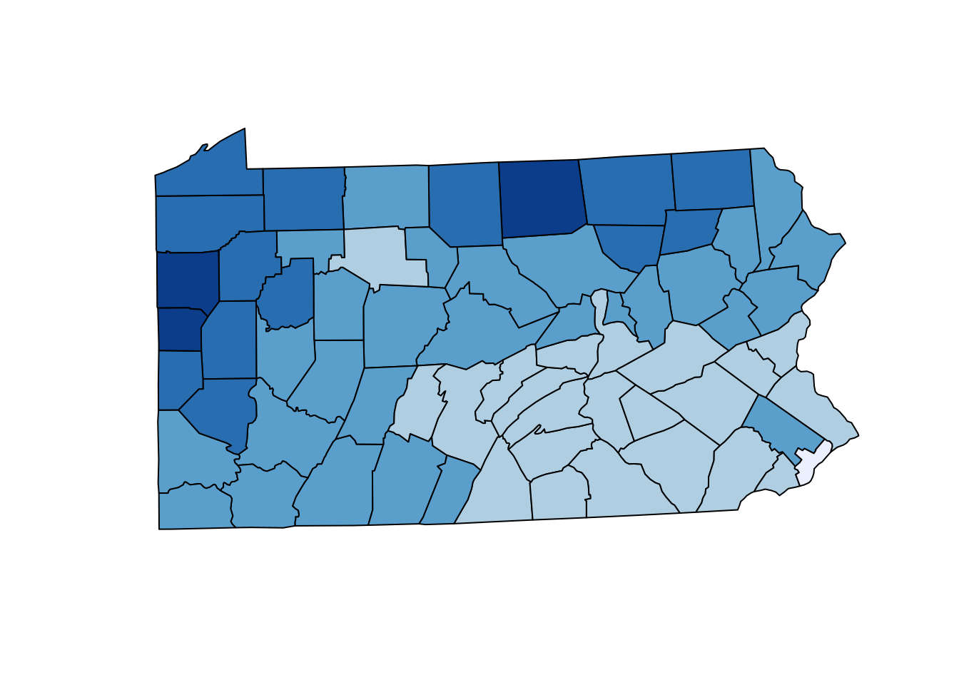
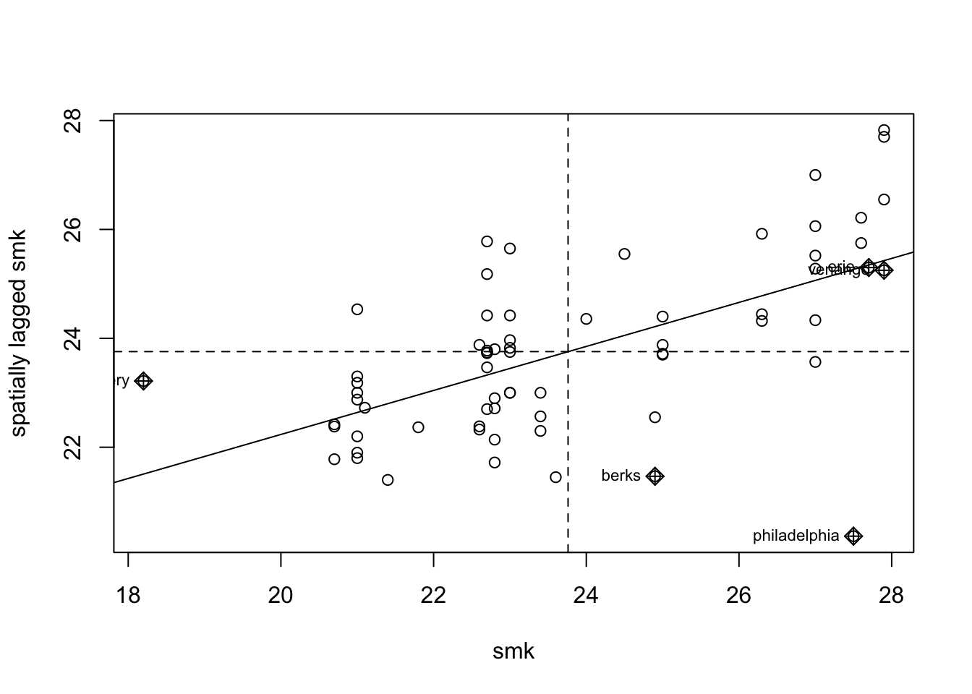
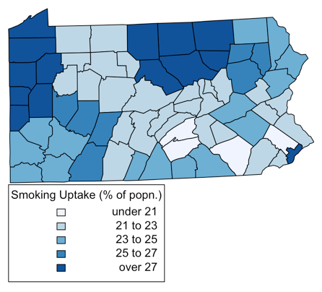
Example : Parallel spatial autocorrelation
Spatial autocorrelation
The extent to which points that are “close together” in space have similar values, on average (e.g., Is there a spatial pattern?).
Pennsylvania smoking rates
The figure shows smoking uptake based on the percentage of population
some degree of correlation between nearby observations.
Notes:
Spatial lagged means of smoking uptake rates (right figure)
The lagged mean is a weighted combination of values of the neighbors.
When nearby polygons tend to have similar Z_i values, there should be a linear trend in the plots.
If each Z_i is independent, the plots will show no pattern.

Slide 37
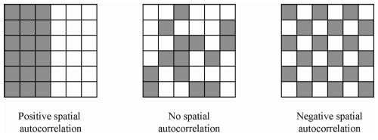
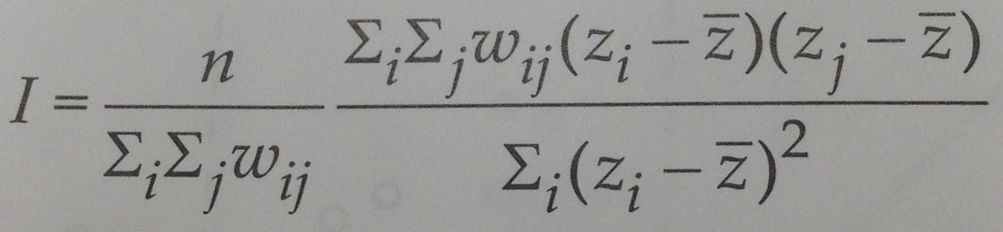
Example : Parallel spatial autocorrelation
Moran’s I is an index of autocorrelation¹.
Where w_ij is the (i,j)th element of a weights matrix W, specifying the degree of dependency between i and j.
n is the number of observations.
Z_{i} –\bar Z indicates deviations from mean.
Large values of I suggest that there is a stronger relationship between nearby z_{i} values. Furthermore, I may be negative in some circumstances – suggesting that there can be a degree of inverse correlation between nearby z_{i} values.
The range of Moran’s I is [-1, 1] – this interval can shrink or expands.
Anselin, L. (1995). Local indicators of spatial association-LISA. Geographical analysis, 27(2), 93-115.

Slide 38
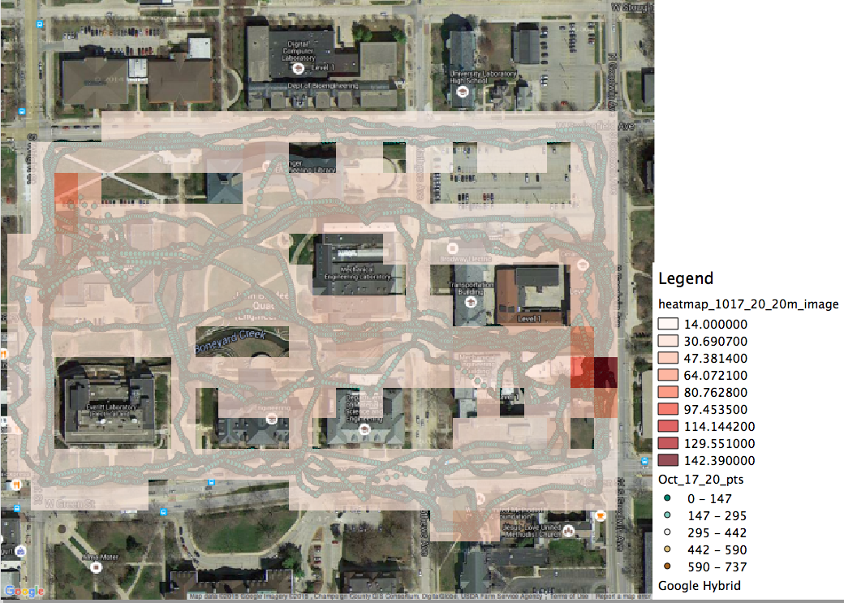
Example : Radiation spatial autocorrelation
Radiation measurements on UIUC campus.
Acknowledgement of data use
Prof. Clair, the Department of NPRE shares her group data for the CyberGIS workshop.

Slide 39
Radiation spatial autocorrelation
Step 1: Moran’s I serial implementation
require(maptools)
require(spdep)
#an absolute file path representing the current working directory of the R process
getwd()
#set the working directory
setwd("~/cybergis_r")
#Get shapefile header information in the radiation data
getinfo.shape(”Oct_17_20_proj.shp")
#Reads data from a points shapefile
radiation<-readShapePoints (” cybergis_r/Oct_17_20_proj.shp")
#Retrieve spatial coordinates from a Spatial object
coords<-coordinates(radiation)
IDs<-row.names(as(radiation, "data.frame"))
#Neighbourhood contiguity by distance
radiation_nei<-dnearneigh(coords, d1=0, d2=20, row.names=IDs)
#Spatial weights for neighbours lists
radiation_nbq_wb<-nb2listw(radiation_nei, style="W")
#Moran's I test for spatial autocorrelation
moran.test(radiation$field_5, listw=radiation_nbq_wb)

Slide 40
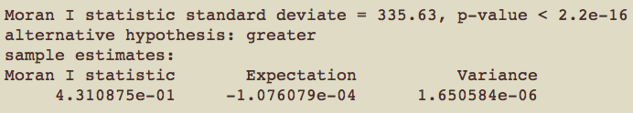
Radiation spatial autocorrelation
Step 1: Moran’s I serial implementation
#Moran's I test for spatial autocorrelation
moran.test(radiation$field_5, listw=radiation_nbq_wb)
Notes:
Advantage
Do whatever you want with them
Get the best performance
Limitations
Need code development
In some case, the analysis workflow may need be changed.

Slide 41
Radiation spatial autocorrelation
Step 2: Moran’s I parallel implementation
gamma <- radiation$field_5
listw <- radiation_nbq_wb nsim <- 999
require(foreach)
require(doSNOW)
n <- length(listw$neighbours)
S0 <- Szero(listw)
cluster = makeCluster(10, type = "SOCK")
registerDoSNOW(cluster)
clusterExport(cluster, c("gamma", "listw","n","S0"))
results = foreach(n = 1:nsim, .combine = c) %dopar% {
library(spdep); moran(sample(gamma), listw, n, S0,zero.policy=NULL)$I
}

Slide 42
Radiation spatial autocorrelation
Step 2: Parallel Moran’s I calculation
paMoran <- function(res, x, listw, nsim,zero.policy=NULL,alternative="greater") {
n <- length(listw$neighbours)
S0 <- Szero(listw)
res[nsim+1] <- moran(x, listw, n, S0, zero.policy)$I
rankres <- rank(res)
xrank <- rankres[length(res)]
diff <- nsim - xrank
diff <- ifelse(diff > 0, diff, 0)
if (alternative == "less")
pval <- punif((diff + 1)/(nsim + 1), lower.tail=FALSE)
else if (alternative == "greater")
pval <- punif((diff + 1)/(nsim + 1))
statistic <- res[nsim+1]
names(statistic) <- "statistic"
parameter <- xrank
names(parameter) <- "observed rank"
method <- "Parallel Monte-Carlo simulation of Moran's I"
lres <- list(statistic=statistic, parameter=parameter,
p.value=pval, alternative=alternative, method=method,res=res)
lres
}

Slide 43
Radiation spatial autocorrelation
Step 2: Parallel Moran’s I calculation
mtest <- paMoran(results,gamma,listw,nsim)
mtest$method => Parallel Monte-Carlo simulation of Moran's I
mtest$statistic => 0.43109
mtest$parameter => observed rank 1000
mtest$p.value => 0.001

Slide 44
Unit 2.2 R and Hadoop
Objective:
Hadoop Architecture
Overview of MapReduce
RHadoop
Demo: RHadoop on Amazon Elastic MapReduce
SparkR
Lab 3:

Slide 45
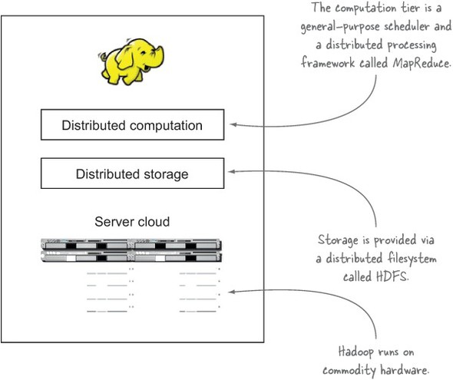
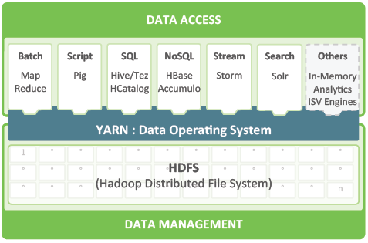
Hadoop Architecture
What is Hadoop?
The Hadoop environment is a distributed system that runs on commodity hardware.
Data in Hadoop is stored on a file systems refereed to as HDFS – the Hadoop Distributed File System: Files stored in HDFS are broken down into blocks and replicated across DataNodes.
Scalable and Fault tolerant
The image comes from Hortonworks (http://hortonworks.com/)
Notes:
HDFS is a distributed filesystem that stores files across all of the nodes in a Hadoop cluster.
It handles breaking the files into large blocks and distributing them across different machines, including making multiple copies of each block so that if any one machine fails no data is lost. It presents a POSIX-like interface to users.
HDFS is the storage mechanism for Hadoop. YARN is the computing mechanism for hadoop.
By default, Pig reads input files from HDFS, uses HDFS to store intermediate data between MapReduce jobs, and writes its output to HDFS.

Slide 46
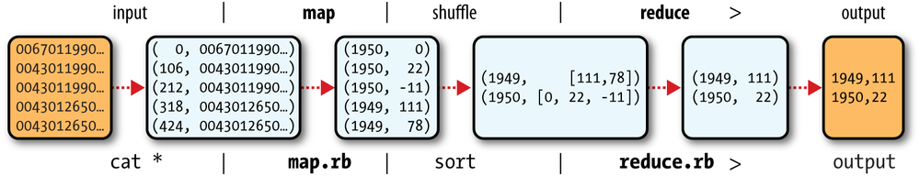
MapReduce
MapReduce is a programming model for data processing.
MapReduce works by breaking the processing into two main phases:
Map phase: data is input into the Mapper, where it is transformed and prepared for the Reducer.
Reduce phase: retrieve the data from the Mapper and perform or analysis.
Understanding MapRedue flow
Notes:
In order to use Hadoop, Understanding Mapreduce
Wordcount in Mapreduce

Slide 47
RHadoop
RHadoop is a collection of R packages that enables users to process and analyze big data with Hadoop.
https://github.com/RevolutionAnalytics/RHadoop/wiki
In RHadoop, there are five main packages, which are:
rmr: This is an interface between R and Hadoop MapReduce, which calls the Hadoop streaming MapReduce API to perform MapReduce jobs across Hadoop clusters.
Rhdfs: This is an interface between R and HDFS, which calls the HDFS API to access the data stored in HDFS
Rhbase: You can use rhbase to read/write data and manipulate tables stored within HBase.
Plyrmr: This is a higher-level abstraction of MapReduce, which allows users to perform common data manipulation in a plyr-like syntax.
Ravro: This allows users to read avro files in R, or write avro files.

Slide 48
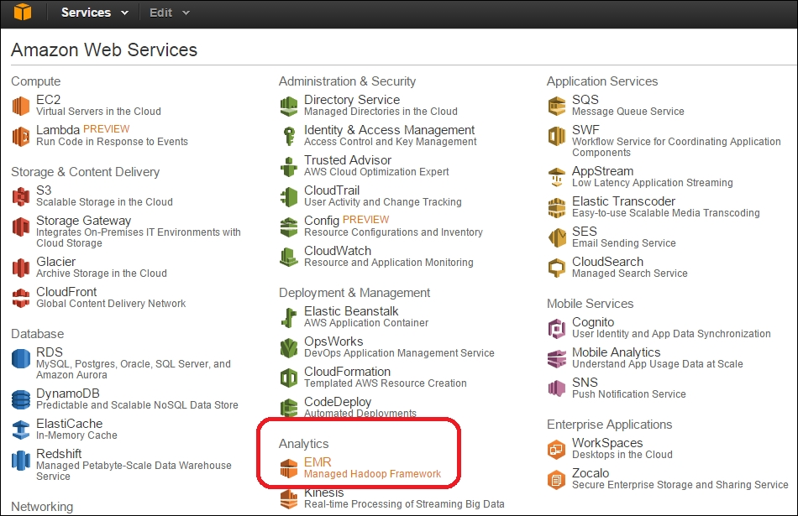
Demo 1: RHadoop on Amazon Elastic MapReduce
Objective:
Operating HDFS with rhdfs
Implementing a word count problem with RHadoop
A MapReduce version of linear regression
Notes:
For data exploration, jupyter/ipython or beaker are great. but for serious code that will be deployed, spyder, pycharm, etc.

Slide 49
Spark
Apache Spark is a general-purpose cluster computing system to process big data workloads.
What sets Spark apart from its predecessors, such as MapReduce, is its speed, ease-of-use, and sophisticated analytics.
Spark makes use of the memory for storage.
In MapReduce, memory is primarily used for actual computation.
Spark uses memory both to compute and store objects.
Spark also provides a unified runtime connecting to various big data storage sources, such as HDFS, Cassandra, HBase, and S3.
It also provides a rich set of higher-level libraries for different big data compute tasks, such as machine learning, SQL processing, graph processing, and real-time streaming.

Slide 50

SparkR
+
Fast
Scalable
Interactive Shell
Statistics
Packages
Plot

Slide 51
Lab 3: SparkR
Objective:
Learn how to run SparkR
Location of files:
cybergis_r
Before you begin:
SSH into the ROGER system.
Environmental variable setting
vi ~/.bashrc -- open bashrc file
#Hadoop
export R_LIBS=/home/cgtrn50/R
export HADOOP_CMD="/usr/bin/hadoop"
export HADOOP_STREAMING="/usr/hdp/2.3.2.0-2602/hadoop-mapreduce/hadoop-streaming-2.7.1.2.3.2.0-2602.jar”
#Spark
export SPARK_HOME=/home/cgtrn50/cybergis_r/spark-1.6.2-bin-hadoop2.6/:$SPARK_HOME
source ~/.bashrc – refresh the bashrc file.
Log in Hadoop cluster
ssh cg-hm08

Slide 52
SparkR
Set up the SPARK_HOME
Sys.setenv(SPARK_HOME = "/home/cgtrn**/cybergis_r/spark-1.6.2-bin-hadoop2.6")
Set up the HADOOP config dir
Sys.setenv (YARN_CONF_DIR="/usr/hdp/current/hadoop-client/conf")
Sys.setenv (HADOOP_CONF_DIR="/usr/hdp/current/hadoop-client/conf")
Load sparkR
library(SparkR, lib.loc = c(file.path(Sys.getenv("SPARK_HOME"), "R", "lib")))
Initialize SparkContext
sc <- sparkR.init(sparkPackages="com.databricks:spark-csv_2.10:1.3.0")
Initialize SQLContext
sqlContext = sparkRSQL.init(sc)

Slide 53
SparkR
Define schema
schema <- structType(structField("id", "string",TRUE),
structField("lat", "double",TRUE),
structField("lon", "double",TRUE),
structField("gamma", "integer",TRUE),
structField("time", "double",TRUE))
Directly create a SparkR DataFrame from the source data
df <- read.df(sqlContext, "hdfs://cg-hm08.ncsa.illinois.edu/user/mhjeong/radiation_test.csv", source = "com.databricks.spark.csv", schema)
Print the DataFrame
head(df)
Print the schema of this Spark DataFrame
printSchema(df)

Slide 54
SparkR
Using SQL to select columns of data
First, register the radiation DataFrame as a table
registerTempTable(df, "radiationTable")
radDF <- sql(sqlContext, "SELECT id,lat,lon,gamma FROM radiationTable")
Use collect to create a local R data frame
local_df <- collect(radDF)
Print the newly created local data frame and calculate a threshold
head(local_df)
s<-sd(local_df$gamma)
m<-mean(local_df$gamma)
threshold<-m + 3*s
Filter radiation data based on a threshold
alarmDF <- filter(radDF, radDF$gamma > threshold)
Save the contents of the DataFrame to a data source
write.df(alarmDF, "hdfs://cg-hm08.ncsa.illinois.edu/user/cgtrn**/alarm_radiation.csv", source = "com.databricks.spark.csv")
Stop the SparkContext now
sparkR.stop()

